Slide 1



Noida Institute of Engineering and Technology, Greater Noida
DATA VISUALIZATION
Unit: 5
Data Analytics ACSAI0512
Dr. Kumod Kumar Gupta
Assistant Professor
CSE-AI
B.Tech 5th Semester

Slide 2

Evaluation Scheme
B. Tech (Data Science)
Fifth Semester
Professional Elective Course
DATA ANALYTICS
L T P | Credits
3 – 0 – 0 | 3

Slide 3
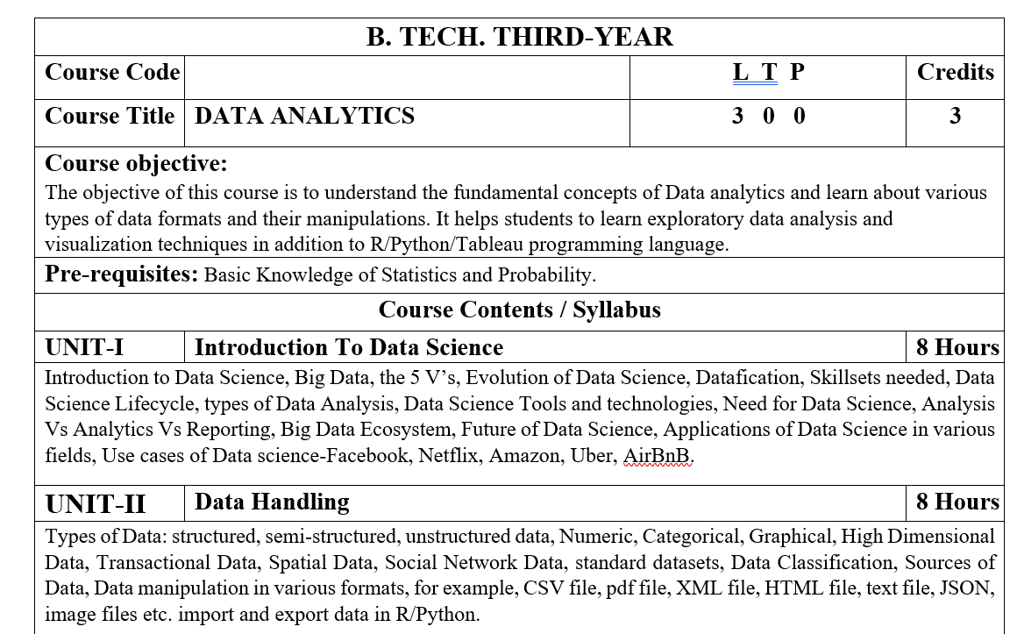
Course Contents / Syllabus

Slide 4
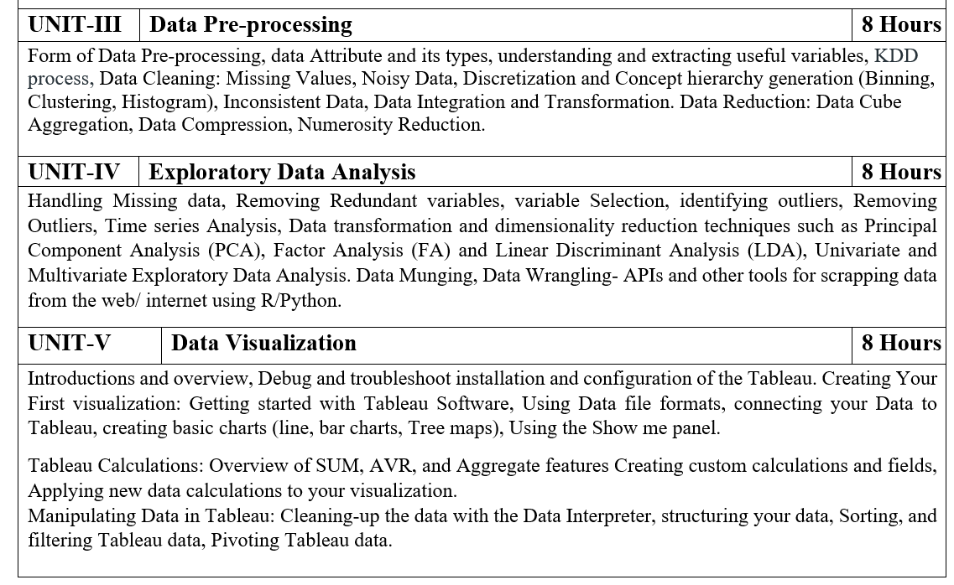
Course Contents / Syllabus

Slide 5
Text Books
Text books:
1) Glenn J. Myatt, Making sense of Data: A practical Guide to Exploratory Data Analysis and Data Mining, John Wiley Publishers, 2007.
2) Data Analysis and Data Mining, 2nd Edition, John Wiley & Sons Publication, 2014.
Reference Books:
1) Open Data for Sustainable Community: Glocalized Sustainable Development Goals, Neha Sharma, Santanu Ghosh, Monodeep Saha, Springer, 2021.
2) The Data Science Handbook, Field Cady, John Wiley & Sons, Inc, 2017
3) Data Mining Concepts and Techniques, Third Edition, Jiawei Han, Micheline Kamber, Jian Pei, Morgan Kaufmann, 2012.

Slide 6
Branch wise Applications
Security.
Transportation.
Risk detection.
Risk Management.
Delivery.
Fast internet allocation.
Reasonable Expenditure.
Interaction with customers.
Planning of cities

Slide 7
Course Objective
The objective of this course is to understand the fundamental concepts of Data analytics and learn about various types of data formats and their manipulations.
It helps students to learn exploratory data analysis and visualization techniques in addition to R/Python/Tableau programming language.

Slide 8

Course Outcomes
Course outcome: After completion of this course students will be able to:
CO 1 | Understand the fundamental concepts of data analytics in the areas that plays major role within the realm of data science. | K1
CO2 | Explain and exemplify the most common forms of data and its representations. | K2
CO3 | Understand and apply data pre-processing techniques. | K3
CO4 | Analyse data using exploratory data analysis. | K4
CO5 | Illustrate various visualization methods for different types of data sets and application scenarios. | K3

Slide 9
Program Outcomes
1. Engineering knowledge
2. Problem analysis
3. Design/development of solutions
4.Conduct investigations of complex problems
5. Modern tool usage
6. The engineer and society
7. Environment and sustainability
8. Ethics:
9. Individual and team work
10. Communication
11. Project management and finance
12. Life-long learning

Slide 10
CO-PO Mapping

Slide 11
Program Specific Outcomes(PSOs)
On successful completion of B. Tech. (DS) Program, the Data Science graduates will be able to:
PSO1:- Analyze, design and develop solutions by applying fundamental concepts of Data Science.
PSO2:-Apply technical knowledge while using modern tools and technologies for solving complex problems.
PSO3:-Collaborate different fields of science and technology with right attitude, to work as an individual or as a team, and demonstrating professional ethics for the well-being of the society.

Slide 12
COs and PSOs Mapping
Course Outcomes | Program Specific Outcomes
 | PSO1 | PSO2 | PSO3 | PSO4

Slide 13
Program Educational Objectives (PEOs)
Solve real-time complex problems and adapt to technological changes with the ability of lifelong learning.
Work as data scientists, entrepreneurs, and bureaucrats for the goodwill of the society and pursue higher education.
Exhibit professional ethics and moral values with good leadership qualities and effective interpersonal skills.

Slide 14
Faculty wise Result Analysis
Semester & Section | Subject Code | Result

Slide 15

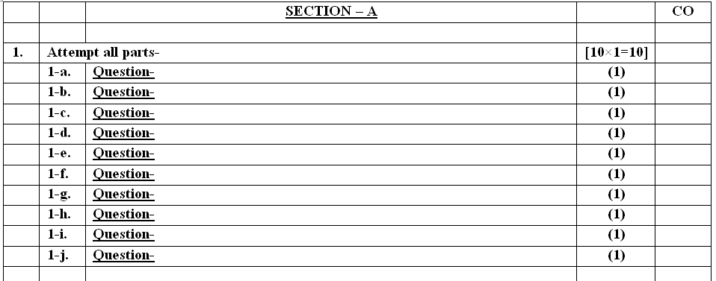
End Semester Question Paper Templates (Offline Pattern/Online Pattern

Slide 16

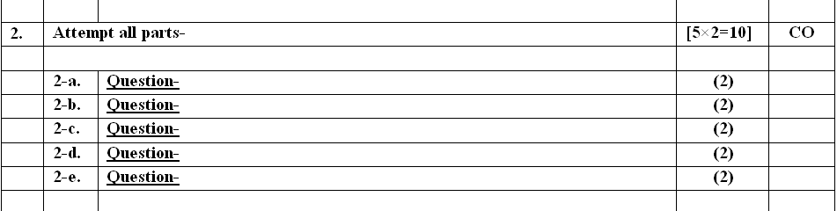
End Semester Question Paper Templates (Offline Pattern/Online Pattern

Slide 17
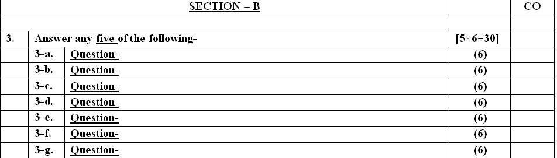
End Semester Question Paper Templates (Offline Pattern/Online Pattern

Slide 18
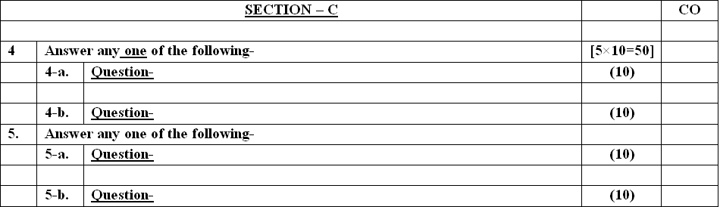
End Semester Question Paper Templates (Offline Pattern/Online Pattern

Slide 19

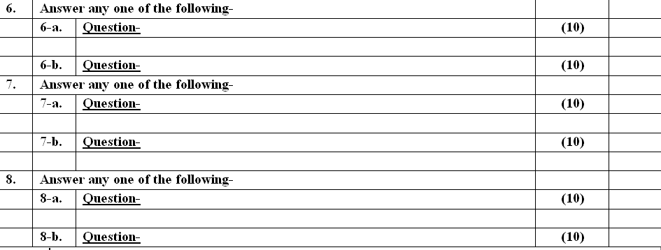
End Semester Question Paper Templates (Offline Pattern/Online Pattern

Slide 20
Unit -5 Data Visualization
Introductions and overview, Debug and troubleshoot installation and configuration of the Tableau. Creating Your First visualization: Getting started with Tableau Software, Using Data file formats, connecting your Data to Tableau, creating basic charts (line, bar charts, Tree maps), Using the Show me panel.
Tableau Calculations: Overview of SUM, AVR, and Aggregate features Creating custom calculations and fields, Applying new data calculations to your visualization. Manipulating Data in Tableau: Cleaning-up the data with the Data Interpreter, structuring your data, Sorting, and filtering Tableau data, Pivoting Tableau data.

Slide 21
Prerequisite and Recap
Prerequisite:-
Basic Knowledge of Statistics and Probability
Basic knowledge of Python Programming.
Recap-
To cleared the knowledge about the types of data, data classification and data manipulation.
To Know the basic concept of Exploratory data analysis.
Student have knowledge about data outliers.

Slide 22
Unit Objective
The objective of the Unit 5 is :
To Debug and troubleshoot installation and configuration of the Tableau.
To know about Tableau Software and Create Your First visualization.
To study how to connect Data to Tableau .
To Create custom calculations and fields.
5. To discuss new data calculations to visualization and Manipulating Data in Tableau.

Slide 23
Topic Objective
Objective: to study the introduction of Tableau and why we use Tableau and Features of Tableau.
Recap- basic knowledge of Exploratory Data Analysis .

Slide 24
Introduction to Tableau
Tableau is the fastly growing and powerful data visualization tool. Tableau is a business intelligence tool which helps us to analyze the raw data in the form of the visual manner; it may be a graph, report, etc.
Example: - If you have any data like Big Data, Hadoop, SQL, or any cloud data and if you want to analyze that given data in the form of pictorial representation of data, you can use Tableau.

Slide 25
Introduction to Tableau
Data analysis is very fast with Tableau, and the visualizations created are in the form of worksheets and dashboards. Any professional can understand the data created using Tableau.
Tableau software doesn't require any technical or any programming skills to operate. Tableau is easy and fast for creating visual dashboards.

Slide 26
Introduction to Tableau
Why use Tableau?
Here are some reasons to use Tableau:
Ultimate skill for Data Science
User-Friendly
Apply to any Business
Fast and Easy
You don't need to do any Coding
Community is Huge
Hold the power of data
It makes it easier to understand and explain the Data Reports

Slide 27
Introduction to Tableau
Features of Tableau
Data Blending: Data blending is the most important feature in Tableau. It is used when we combine related data from multiple data sources, which you want to analyze together in a single view, and represent in the form of a graph.
Real-time analysis: Tableau can help extract valuable information from fast moving data with interactive analytics.
The Collaboration of data: Team members can share data, make follow up queries, and forward easy-to-digest visualizations to others who could gain value from the data.

Slide 28
Topic Objective
Objective: To study about how to Debug and troubleshoot installation and configuration of the Tableau.
Recap- basic knowledge of Exploratory Data Analysis and Data Pre- Processing .

Slide 29
Debug and troubleshoot installation and configuration of the Tableau
General Troubleshooting Steps
Many Tableau Server issues can be addressed with some basic steps:
Make sure there is enough disk space on each computer running Tableau Server. Limited disk space can cause a failure to install, a failure to upgrade, or problems running Tableau Server.
Restart Tableau Server. Issues related to processes not fully started can be resolved by restarting Tableau Server in a controlled way. To restart Tableau Server, use the tsm restart command. This will stop all the processes associated with Tableau Server and then restart them.

Slide 30
Debug and troubleshoot installation and configuration of the Tableau
General Troubleshooting Steps
Reindex Tableau Server. Issues related to indexing can be resolved by reindexing Tableau Server. To reindex Tableau Server, use the tsm maintenance reindex-search command. For more information, see Reindexing Tableau Server Search & Browse below.
Restart the computer on which Tableau Server is running. Some issues, such as those related to data source connectivity, can be resolved by restarting the server computer.

Slide 31
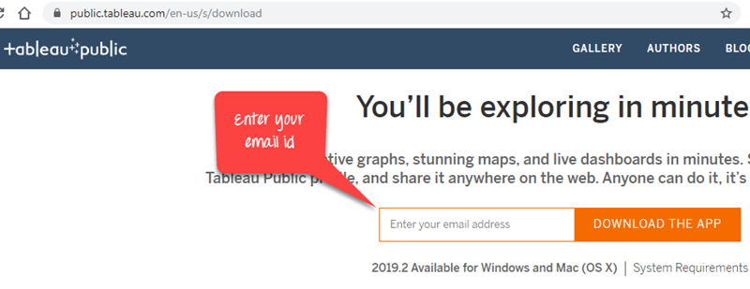
Debug and troubleshoot installation and configuration of the Tableau
Download and Install Tableau
Step 1) Go to https://public.tableau.com/en-us/s/download on your web browser. Now you need to enter your email id and click on “DOWNLOAD THE APP” button.

Slide 32
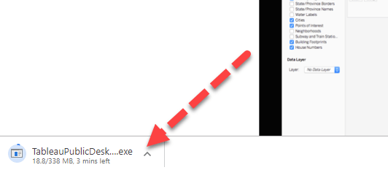
Debug and troubleshoot installation and configuration of the Tableau
Step 2) This will start downloading the .exe file for Windows by default, and you can see the downloading process in the bottom left corner of the website.

Slide 33
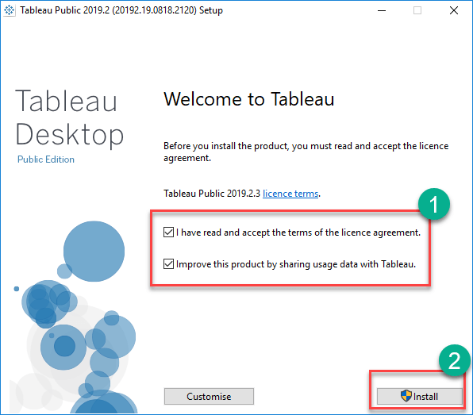
Debug and troubleshoot installation and configuration of the Tableau
Step 3) Open the downloaded file. Accept the terms and conditions and click on “Install” button.

Slide 34
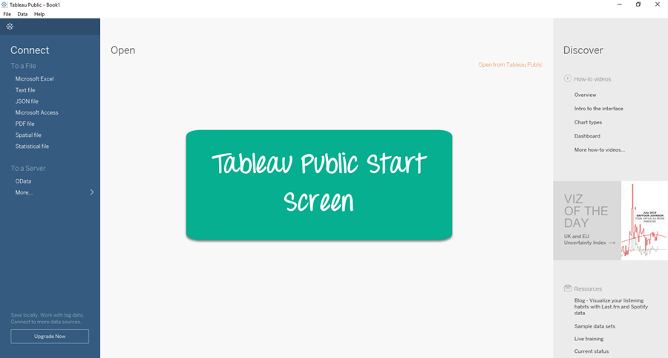
Debug and troubleshoot installation and configuration of the Tableau
Step 4) After installation Start Screen of Tableau is shown

Slide 35
Debug and troubleshoot installation and configuration of the Tableau
Step 4) After installation Start Screen of Tableau is shown

Slide 36
Debug and troubleshoot installation and configuration of the Tableau
Introduction to Data Visualization using Tableau
Tableau is a data analytics and visualization tool. It’s the leading (33% market share followed by Power-BI) data analytics and visualization tool in the market. Tableau comes with a very easy drag-drop interface which makes it easy to learn and you can work on almost every type of data in Tableau.
This makes it an excellent choice for data analysts.

Slide 37
Debug and troubleshoot installation and configuration of the Tableau
Introduction to Data Visualization using Tableau
Tableau is a data analytics and visualization tool. It’s the leading (33% market share followed by Power-BI) data analytics and visualization tool in the market. Tableau comes with a very easy drag-drop interface which makes it easy to learn and you can work on almost every type of data in Tableau.
This makes it an excellent choice for data analysts.

Slide 38
Debug and troubleshoot installation and configuration of the Tableau
Getting Started with Data Visualization using Tableau
Once you have installed Tableau in the system, let’s start with some real-world Data Visualization using Tableau.
Load Data in Tableau:-
Tableau supports various data formats which can be loaded by choosing those options. Under a file we see various options to load data from the local directory and under to a server, we see options to load data from cloud servers. for loading CSV files we select Text file options, for excel and SQL files we choose their respective options.

Slide 39
Debug and troubleshoot installation and configuration of the Tableau
Connect Tableau to the data file:
To open the application, click the Tableau icon on your desktop (or in your Start menu).
In the Connect panel at the left side of the Start page, click the Excel link under the “To a File” heading to the open file selection option.
Using the file selection box, select the Excel worksheet that you want to open, and then click the Open button to continue
Select the Orders sheet from the navigation menu on the left and drag it onto the Drag Sheets Here area, as shown in the above gif.
After loading we can perform data cleaning, data preprocessing, feature extraction to some extent.

Slide 40
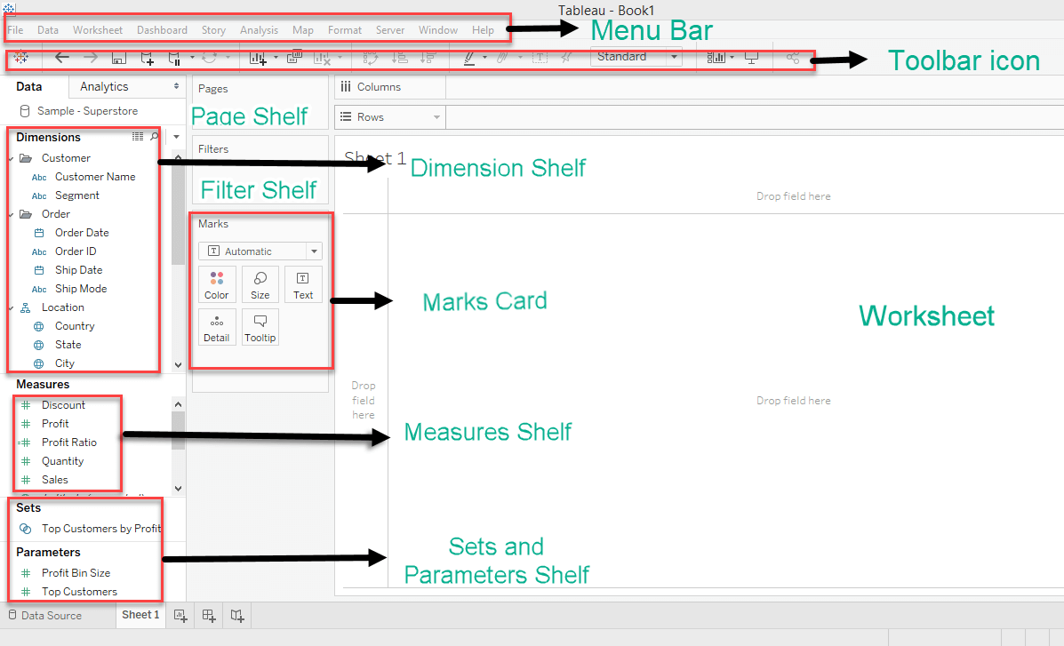
Debug and troubleshoot installation and configuration of the Tableau
Understanding different Sections in Tableau

Slide 41
Debug and troubleshoot installation and configuration of the Tableau
Creating Visuals in Tableau
Let’s begin with the real data visualization using Tableau-
Tableau supports the following data types:
Boolean: True and false can be stored in this data type.
Date/Datetime: This data type can help in leveraging Tableau’s default date hierarchy behavior when applied to valid date or DateTime fields.
Number: These are values that are numeric. Values can be integers or floating-point numbers (numbers with decimals).
String: This is a sequence of characters encased in single or double quotation marks.
Geolocation: These are values that we need to plot maps.

Slide 42
Topic Objective
Objective: to study different type of charts and creating basic charts (line, bar charts, Tree maps).
Recap- basic knowledge of Exploratory Data Analysis and Data Pre-processing .

Slide 43
Creating Basic Charts
Line Chart
The line chart, or line graph, is another familiar method for displaying data. It connects several distinct data points, presenting them as one continuous evolution. The result is a simple, straightforward way to visualize changes in one value relative to another.
Go to a new Worksheet
Drag Order Date into Columns.
Drag Sales into Rows.

Slide 44
Creating Basic Charts
Line Chart
Step 1: Add Dimension Field and Measure Field
Step 2: Add Profit Measure Field to Rows
Step 3: Drag SUM Measure Field to Y-Axis
Step 4: Find the Details of Measure Fields
Step 5: Manage the Appearance of Tableau Line Chart

Slide 45
Creating Basic Charts
Bar Chart
A bar chart or graph is used to represent category wise data of a dataset. The length of the bars is proportional to the value that each category represents. This gives instant insight into the data pictorially. In Tableau, we can create several variants like a simple vertical bar graph (also known as a line graph), segmented bar graph, stacked bar graph and side by side bar chart.

Slide 46
Creating Basic Charts
How to Create a Bar Chart in Tableau?
1. Vertical Bar Chart
Open a new worksheet in your Tableau Desktop with your data set loaded. We are using a dataset of electronic store sales. From our list of dimensions, we add Order Date to the Columns section.

Slide 47
Creating Basic Charts
How to Create a Bar Chart in Tableau?
2. Segmented Bar Chart
We can also create a segmented bar chart in Tableau. For this, we just need to add one more dimension to the Rows section. Like we have added the Segment field into the Rows section along with the SUM(Sales) measure.

Slide 48
Creating Basic Charts
How to Create a Bar Chart in Tableau?
3. Stacked Bar Chart
We can also create a stacked bar chart where a single bar is divided into different sections that are stacked one upon the other. The size of each stacked section depends on the value that the section is representing. Also, each section in a stack is assigned a unique color.

Slide 49
Creating Basic Charts
How to Create a Bar Chart in Tableau?
4. Side-by-Side Bar Chart
Another way of showing multiple values corresponding to a single dimension is by creating a side-by-side bar chart. In a side by side chart, all the values corresponding to a dimension are placed side by side instead of getting stacked upon one another.

Slide 50
Creating Basic Charts
Tree Map
The tree map displays data in nested rectangles. The dimensions define the structure of the tree map and measures define the size or color of the individual rectangle. The rectangles are easy to visualize as both the size and shade of the color of the rectangle reflect the value of the measure.
A Tree Map is created using one or more dimension with one or two measures.

Slide 51
Creating Basic Charts
Creating a Tree Map
Using the Sample-superstore, plan to find the size of profits for each Ship mode values. To achieve this objective, following are the steps.
Step 1 − Drag and drop the measure profit two times to the Marks Card. Once to the Size shelf and again to the Color shelf.
Step 2 − Drag and drop the dimension ship mode to the Label shelf. Choose the chart type Tree Map from Show Me.

Slide 52
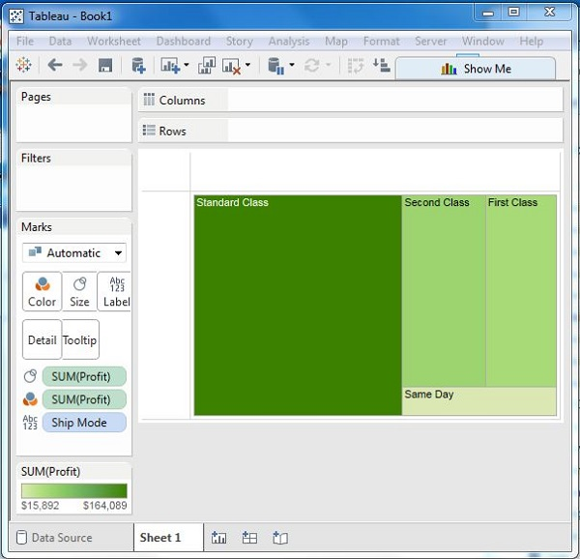
Creating Basic Charts

Slide 53
Creating Basic Charts
Tree Map with Two Dimensions
You can add the dimension Region to the above Tree map chart. Drag and drop it twice. Once to the Color shelf and again to the Label shelf. The chart that appears will show four outer boxes for four regions and then the boxes for ship modes nested inside them. All the different regions will now have different colors

Slide 54
Creating Basic Charts
Show Me in Tableau
Show Me window holds the most commonly used charts in Tableau. You can use any of these charts to view the data. Click Show Me on the toolbar to open this window, as we have shown below.

Slide 55
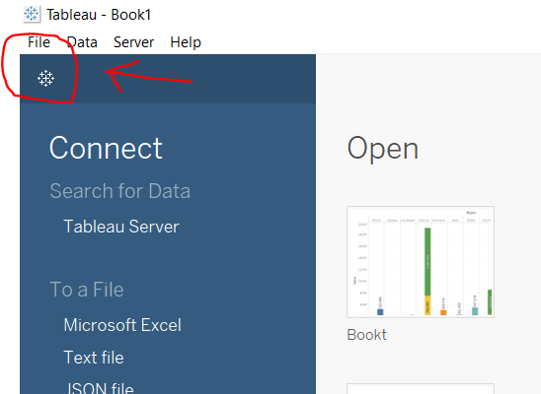
Creating Basic Charts
Steps to generate various illustrations from Show Me window in Tableau:
Open Tableau tool and click on Show start Page.

Slide 56
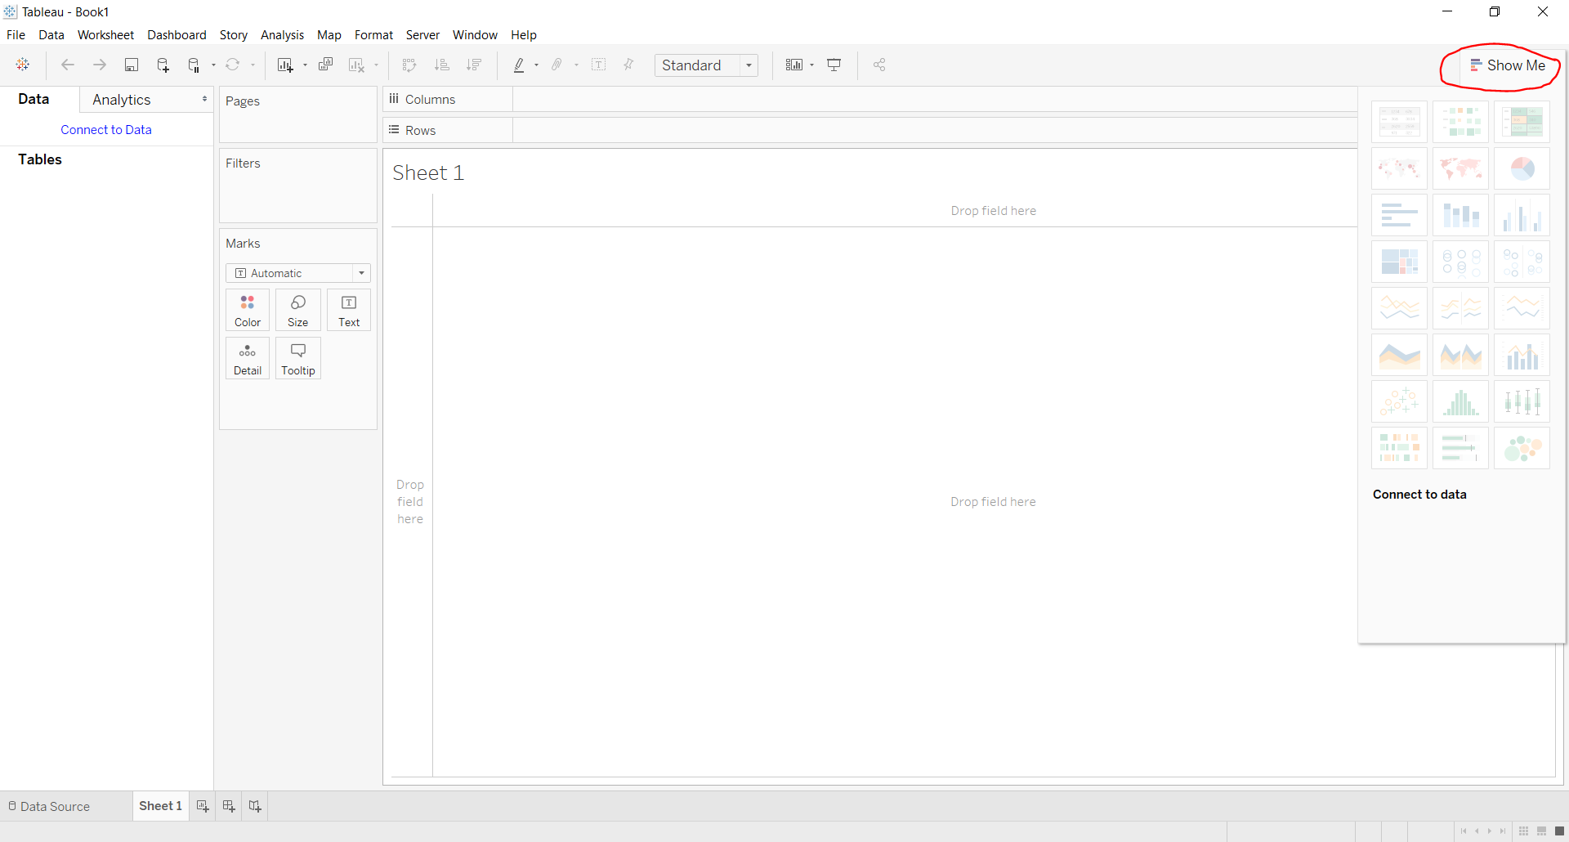
Creating Basic Charts
Steps to generate various illustrations from Show Me window in Tableau:
Click on Show Me Option to view features.

Slide 57
Creating Basic Charts
Steps to generate various illustrations from Show Me window in Tableau:
Here you will get different types of charts and graphs listed below:
Text Label | Symbol Maps | Horizontal Bars | Tree Map
Heat Map | Maps | Stacked Bars | Circle Views
Highlight Table | Pie Charts | Side-by-Side Bars | Side-by-Side Circle Views
Line Chart | Discrete Lines | Dual Lines | Area Chart
Discrete Area Chart | Dual Combination Chart | Scatter Plot | Histograms
Box and Whisker Plots | Gantt Chart | Bullet Graph | Packed Bubbles Chart

Slide 58
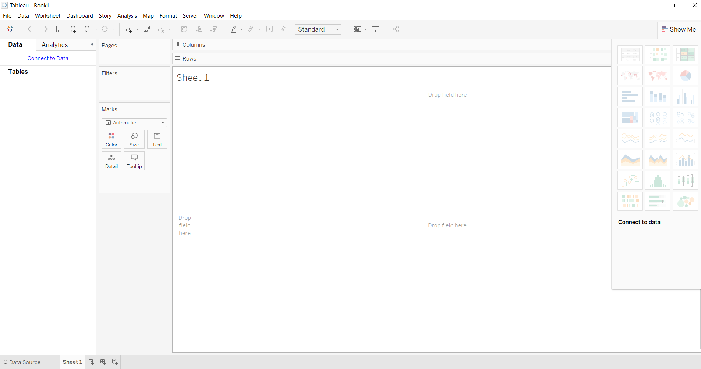
Creating Basic Charts
Steps to generate various illustrations from Show Me window in Tableau:
To use different graphs and charts one should follow some steps: Click on Show Me

Slide 59
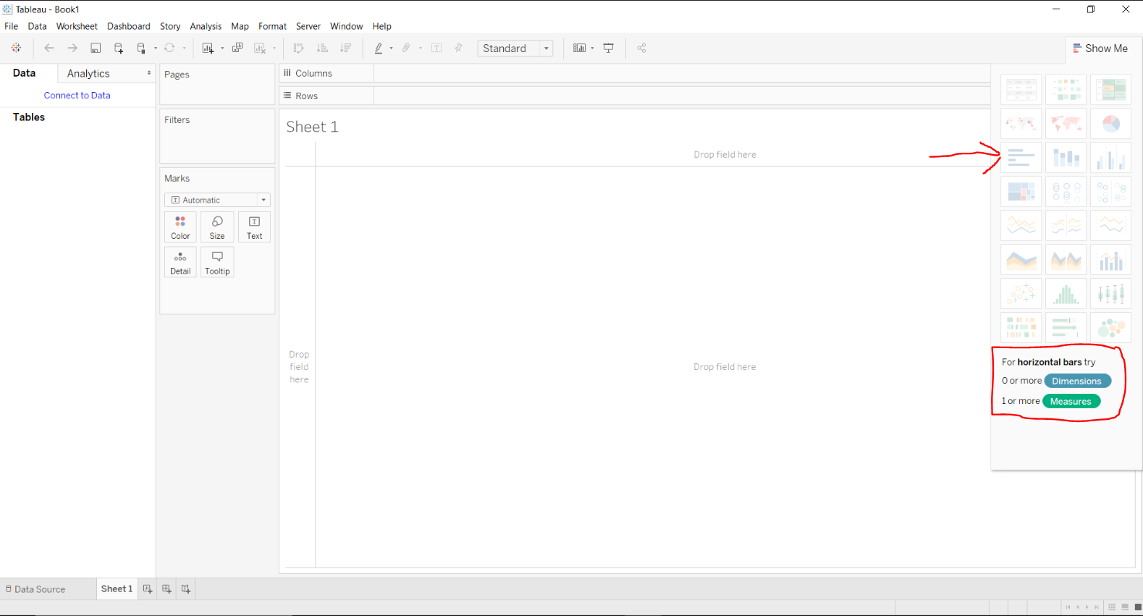
Creating Basic Charts
Steps to generate various illustrations from Show Me window in Tableau:
Hover over a graph/ chart you want to use.
See the requirements

Slide 60
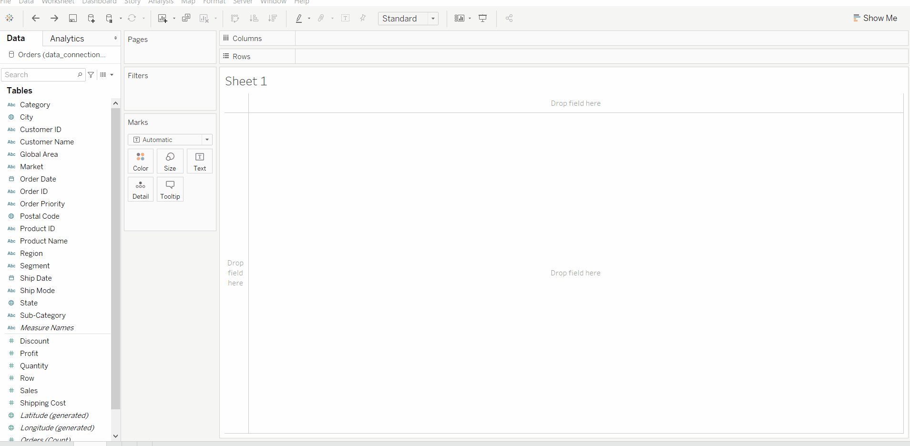
Creating Basic Charts
Steps to generate various illustrations from Show Me window in Tableau:
Fulfill the requirements
At last click on it.

Slide 61
Topic Objective
Objective: To understand the Tableau Calculations: Overview of SUM, AVR, and Aggregate features Creating custom calculations and fields and Applying new data calculations to your visualization.
Recap- basic knowledge of Exploratory Data Analysis and Data Pre-processing .

Slide 62
Tableau Calculations
A table calculation is a transformation that applies to the values in a visualization. They are calculated based on current visualization and do not consider any dimensions or measures that are filtered out of the visualization.
These calculations are applied to the values of the entire table, not on the some selected rows or columns.
Table calculations are used for a variety of purposes, such as:
Transforming values to rankings.
Transforming values to show running totals.
Transforming values to show the percent of the total.

Slide 63
Tableau Calculations
Aggregate Functions
Let's see some essential examples of aggregate functions:
AVG (expression): It returns the average of all the values in the expression. AVG is used only with numeric fields. And the Null values are ignored.
COUNT (expression): It returns the number of items in a group. And the Null values are not counted.

Slide 64
Tableau Calculations
Aggregate Functions
Let's see some essential examples of aggregate functions:
MEDIAN (expression): It returns the median of an expression over all records. Median can only be used with numeric fields, and Null values are ignored.
STDEV (expression): It returns the statistical standard deviation of all values in the given expression based on a sample of the population.

Slide 65
Tableau Calculations
Aggregate Functions
Let's see some essential examples of aggregate functions:
MEDIAN (expression): It returns the median of an expression over all records. Median can only be used with numeric fields, and Null values are ignored.
STDEV (expression): It returns the statistical standard deviation of all values in the given expression based on a sample of the population.

Slide 66
Topic Objective
Objective: To understand how to Manipulate Data in Tableau: Cleaning-up the data with the Data Interpreter, structuring your data, Sorting, and filtering Tableau data, Pivoting Tableau data.
Recap- basic knowledge of Exploratory Data Analysis and Data Pre-processing .

Slide 67
Manipulating Data in Tableau
Tableau has a feature-rich data pane with multiple inbuilt options related to data manipulation, such as changing data types, splitting strings, pivoting or un-pivoting data, creating custom calculations, and so on.

Slide 68
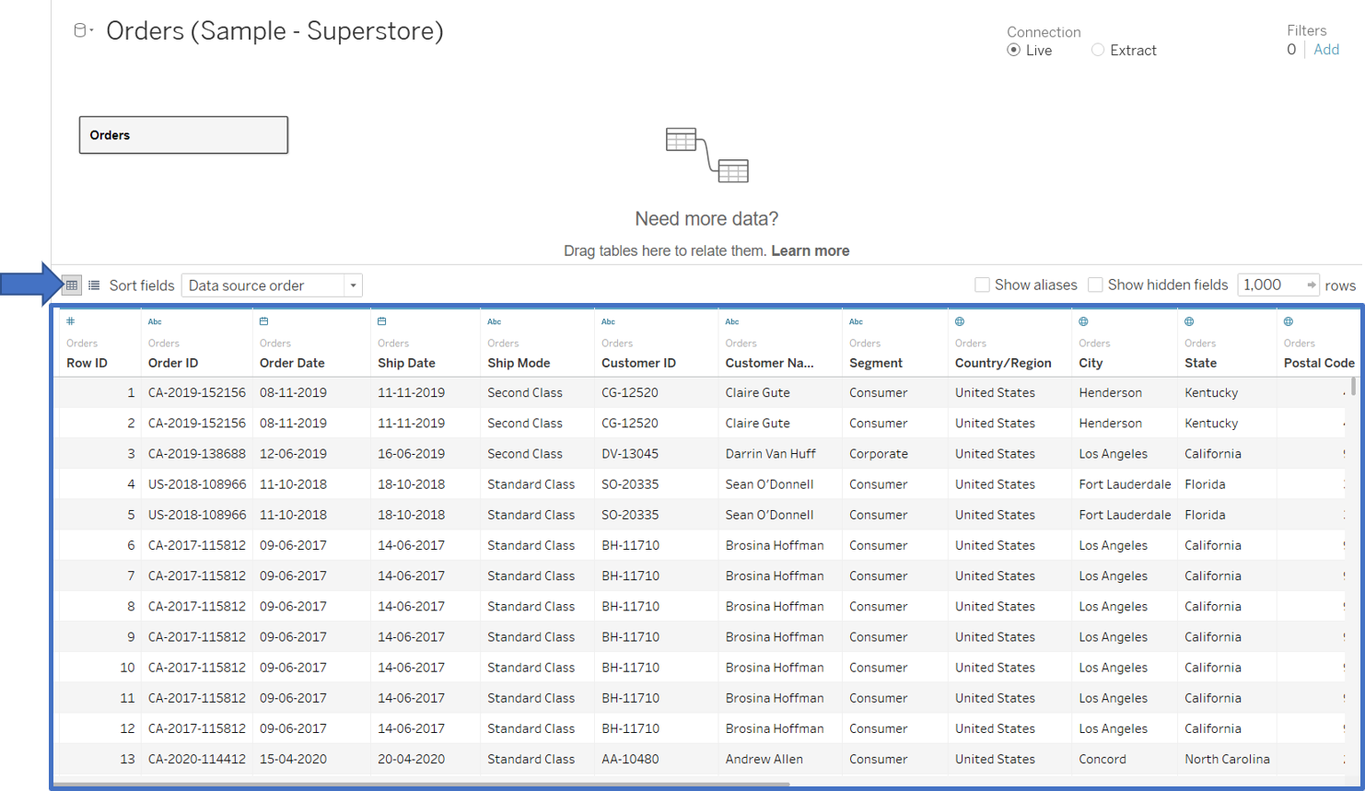
Manipulating Data in Tableau
Data Preview Pane
Once you have connected to your data source in Tableau and have chosen the appropriate data table, a set of sample rows from the chosen data table is shown in the data preview pane for initial exploration of the data.

Slide 69
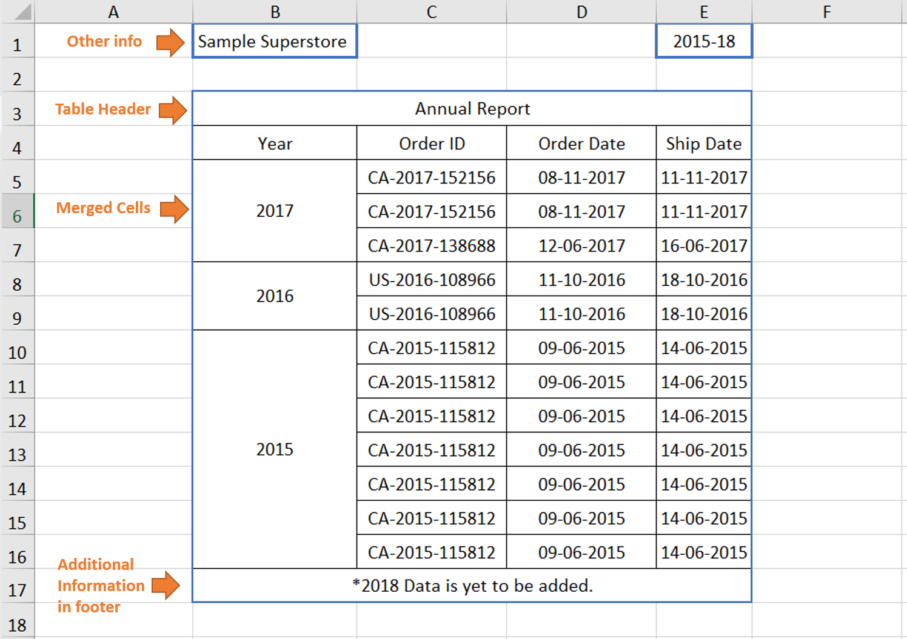
Manipulating Data in Tableau
Data Interpreter
If your data source is Excel, CSV, PDF, or Google Sheets and you are facing data-related challenges like stacked headers, additional information in the adjoining header or footer, sub-tables etc., Tableau has a really useful in-built utility to do the cleaning and identification of the tables in your dataset.

Slide 70
Manipulating Data in Tableau
Data Interpreter
If your data source is Excel, CSV, PDF, or Google Sheets and you are facing data-related challenges like stacked headers, additional information in the adjoining header or footer, sub-tables etc., Tableau has a really useful in-built utility to do the cleaning and identification of the tables in your dataset.

Slide 71
Manipulating Data in Tableau
Data Manipulation
Multiple data manipulation operations can be carried out to make data fit for visualization in the data preview pane or the data pane in the worksheet view. The data manipulation options vary by the data type of the columns. For example, the split option only comes up for string datatype columns, the create bins option only comes up for numeric datatype columns, etc.

Slide 72
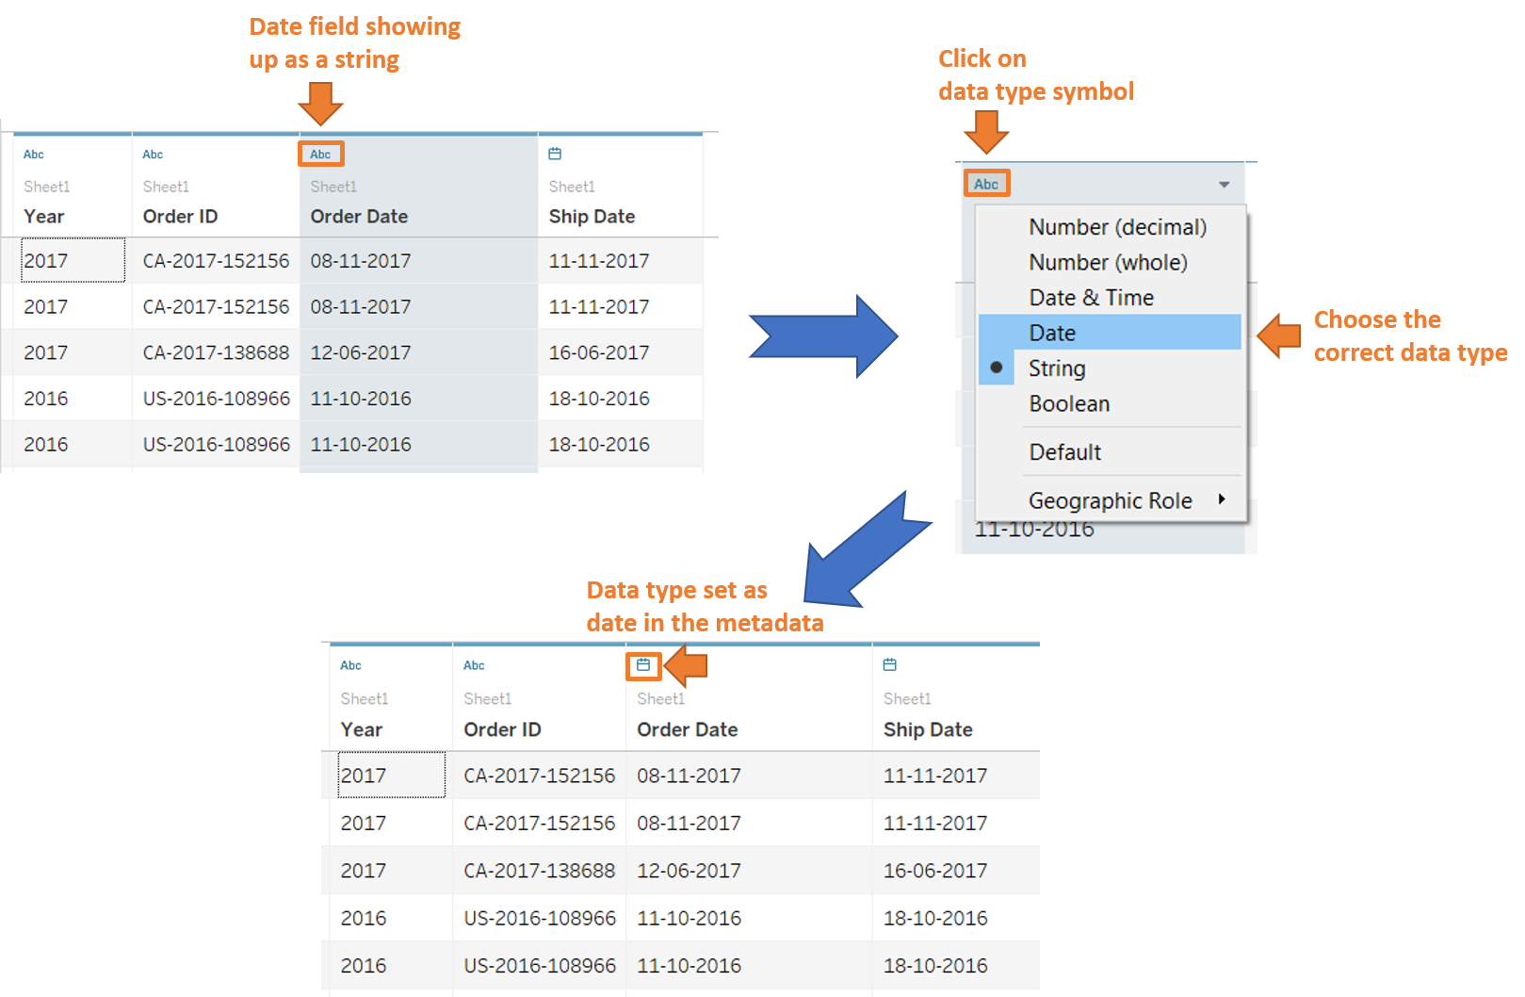
Manipulating Data in Tableau
Change Data Type
If Tableau has inferred a wrong data type for a column, the data type can be changed by clicking on the data type symbol in the column header, as shown below.

Slide 73
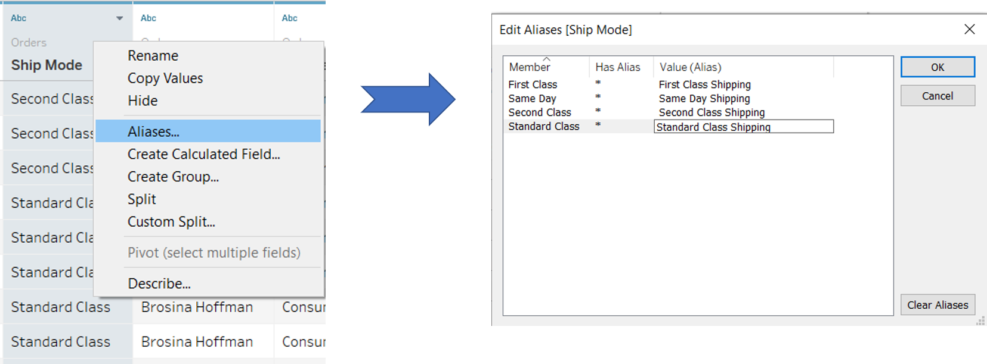
Manipulating Data in Tableau
Hide
Right-click on the column header and select hide to hide an unwanted column from the data view. It is best practice to hide unwanted columns before extract creation in order to reduce the data extract size and reduce latency in load time. Unwanted columns can also be hidden just to prevent any unwanted clutter in the data pane.

Slide 74
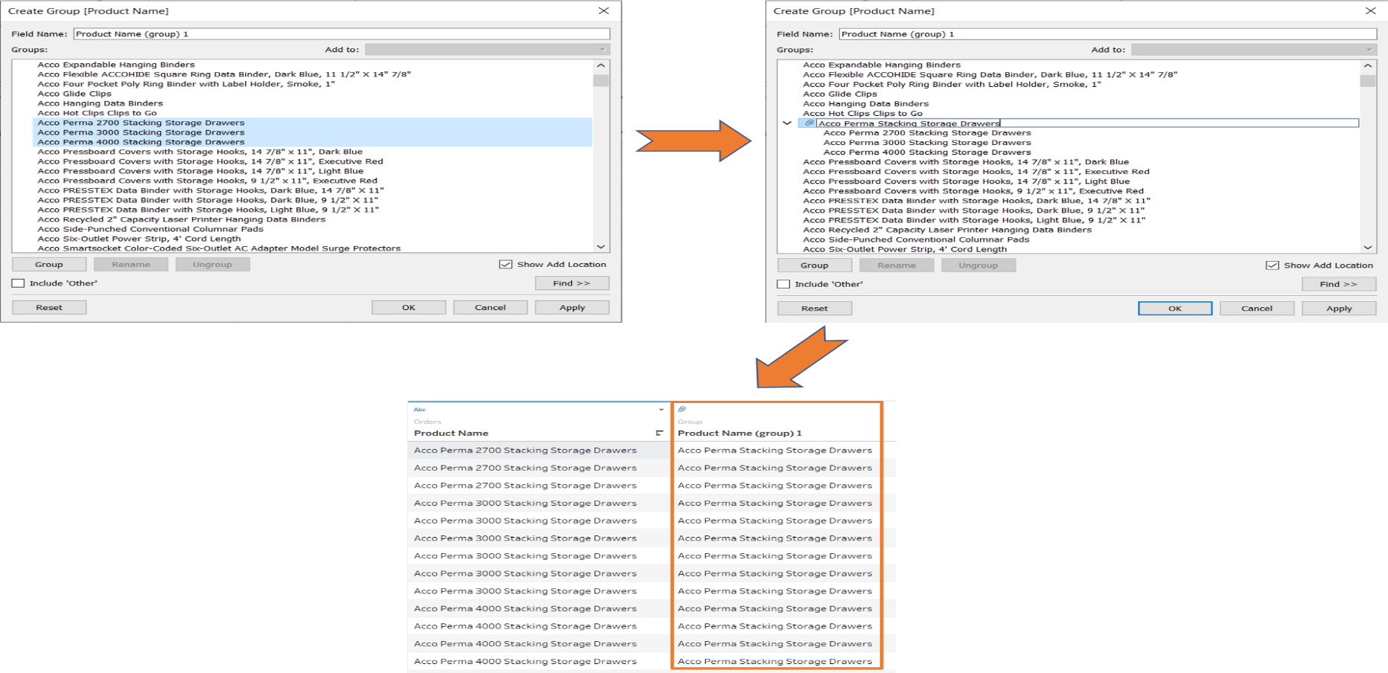
Manipulating Data in Tableau
Group
Groups can be created in Tableau for string datatype column values in order to assign the same alias for multiple values or reduce the granularity of values for a column. To create a group for a column, right click on its header and choose create group.

Slide 75
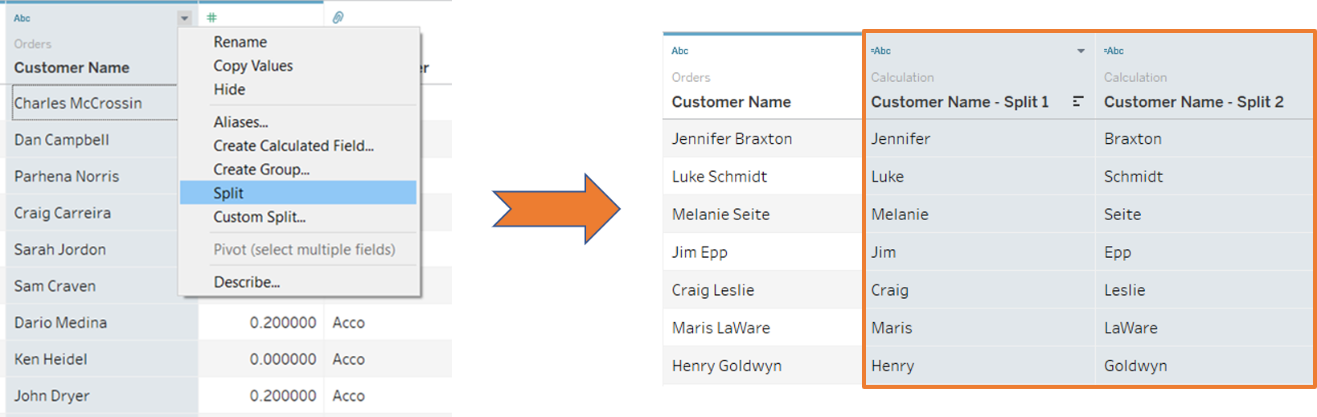
Manipulating Data in Tableau
Split
Columns consisting of string values can be easily split into multiple columns using the split or custom split options. For example, the name field can be split into two columns consisting of the first name and last name using split. Split automatically determines the space delimiter in the string value and splits the strings accordingly.

Slide 76
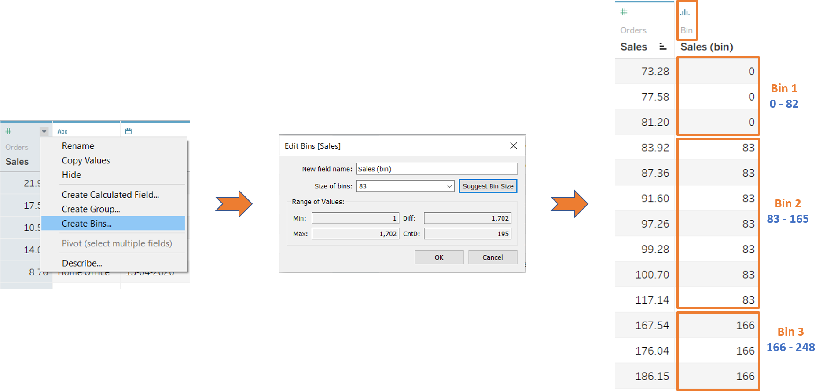
Manipulating Data in Tableau
Bins
The values of a numeric column can be grouped into bins. Bins are used to convert continuous numeric values into discrete sequences of range values. The bins are then used to visualize the trends in histograms.

Slide 77
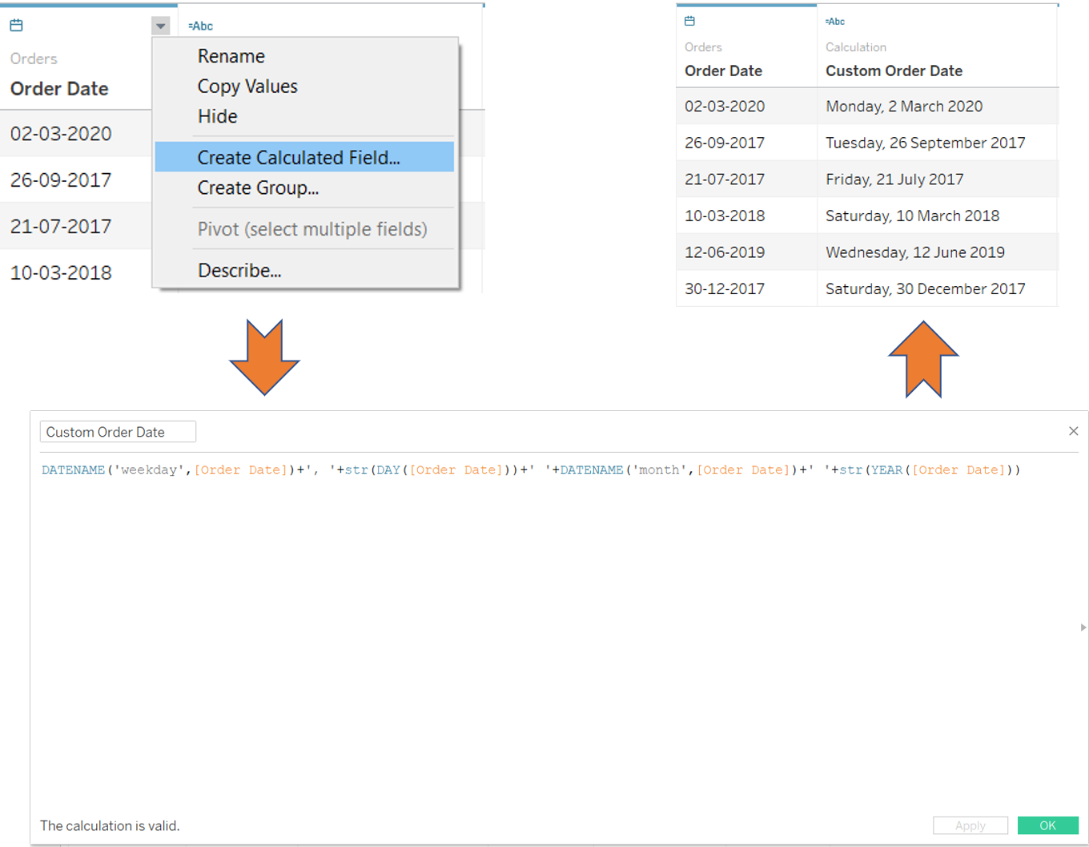
Manipulating Data in Tableau
Calculated Fields
Calculated fields can be used if you need to create customized logic for manipulating certain data types or data values. There are a large-range of functions available in Tableau that can used individually or collectively for data manipulation.

Slide 78
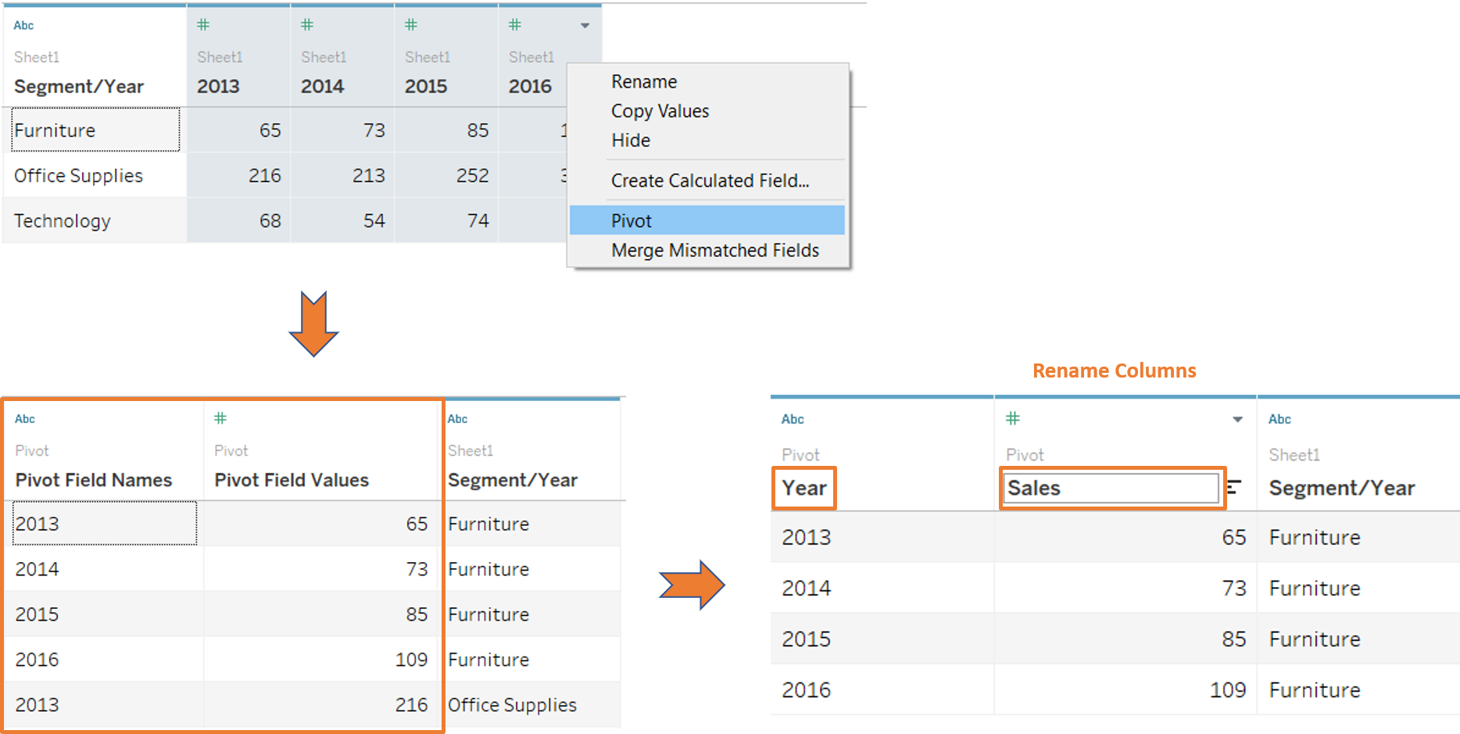
Manipulating Data in Tableau
Pivot
Consider the pivoted dataset shown below. Since the dimension values for the year are the column headers, a chart based on years cannot be plotted. In order to convert this dataset from the pivoted, or wide, shape to the narrow shape, which is preferred for visualization, use the pivot option, as shown below

Slide 79
Topic Objective
Objective: To learn Advanced Visualization Tools: Using Filters, Using the Detail panel Using the Size panels, customizing filters, Formatting your data with colours, Creating Dashboards & Stories, Distributing & Publishing Your Visualization
Recap- basic knowledge of Exploratory Data Analysis and Data Pre-processing .

Slide 80
Advanced Visualization Tools
Tableau Filters
Tableau lets you filter individual views or entire data sources based on dimensions, measures, or sets. In databases, filtering is a useful way to see only the data you want to see. When the data is visualized in a readable, actionable format, Tableau filters are required to highlight any underlying insights that can be derived from it.
Tableau filters are based on a condition that can be used to limit the number of records in the database. Tableau filters support both simple cases based on field values and advanced calculations or context-based filters.

Slide 81
Advanced Visualization Tools
Types of Tableau Filters
Tableau filters can be used to organize and visualize data based on predefined criteria in several ways. Tableau has a total of six different types of filters:
Extract Filter
Data Source Filter
Context Filter
Dimension Filter
Measure Filter
User Filter

Slide 82
Advanced Visualization Tools
Extract Filter
The Tableau filter that extracts a small subset of data from the original data source is the extract filter. If the user extracts data from the data source, this Tableau filter is used.
After connecting the text file to Tableau, you’ll see two options in the top right corner of the data source tab: Live and Extract. A direct connection to a data source is referred to as a live connection.

Slide 83
Advanced Visualization Tools
Data Source Filter
The Tableau Filter that applies the filter directly to the data source, allowing for quick uploads of data is the Data Source Filter. It can limit the number of records in the data set. Both live and extracted connections are supported by the Data Source Filter.

Slide 84
Advanced Visualization Tools
Context Filter
A Context Filter is a standalone Tableau filter that can create a new dataset from the original data set and compute the worksheet selections. Context Filters are used to boost the performance of data source views, filters, and queries. You could run a context filter before any other Tableau Filters, and then apply the

Slide 85
Advanced Visualization Tools
Dimension Filter
In Tableau, dimensions are independent fields, typically any field that contains categorical or qualitative data. Dimension Filters are those Tableau Filters that are applied to dimensional data. It’s a non-aggregated filter that allows you to add a dimension, group, sets, and bins. The top or bottom conditions, wildcard match, and formula can all be used to apply a Dimension Filter.

Slide 86
Advanced Visualization Tools
Dimension Filter
In Tableau, dimensions are independent fields, typically any field that contains categorical or qualitative data. Dimension Filters are those Tableau Filters that are applied to dimensional data. It’s a non-aggregated filter that allows you to add a dimension, group, sets, and bins. The top or bottom conditions, wildcard match, and formula can all be used to apply a Dimension Filter.

Slide 87
Advanced Visualization Tools
Measure Filter
The Tableau Filter that can be used to filter data based on the values in a measure is called the Measure Filter. Fields containing quantitative data are commonly referred to as measures. The data can be modified using the aggregated measure values in a Measure Filter.

Slide 88
Advanced Visualization Tools
User Filter
The Tableau filter that protects the row-level data in a dataset is the User Filter. When the workbook is published on a server, it can be used. For different users, different filtering conditions can be used. It’s the process of limiting what data a user can see depending on who’s looking at the dashboard.

Slide 89
Advanced Visualization Tools
Tableau Color Formatting
The use of Tableau color is extremely important in the presentation of your viz, just like Tableau size. Tableau color can be used in two different ways on the Marks card. If you drag a Dimension to the Tableau Color shelf, Tableau will give you a color for each one of the dimensions in the field.

Slide 90
Advanced Visualization Tools
Tableau Color Formatting
Using the view we created for the hierarchies and sorting module, drag off Product Name, so we only see Product Category and Product Sub-category in the view.
Drag Product Category from Dimensions to the Color shelf. (If you drag it off columns, you will still get the same colors, but they will not be grouped. Rather, the chart will order the bars by alphabetical Product Name.)

Slide 91
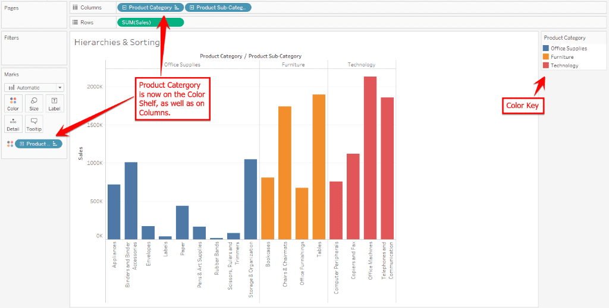
Advanced Visualization Tools
Tableau Color Formatting
3.You’ll now see three colors, one representing each category (Orange for office supplies, blue for furniture, green for technology).

Slide 92
Advanced Visualization Tools
Now go back to Dimensions and drag Product Sub-category right on top of the Product Category pill on the Color shelf. This will replace category in the colors with the breakout by sub-category.
You’ll now see a number of different colors, one for each of the categories.

Slide 93
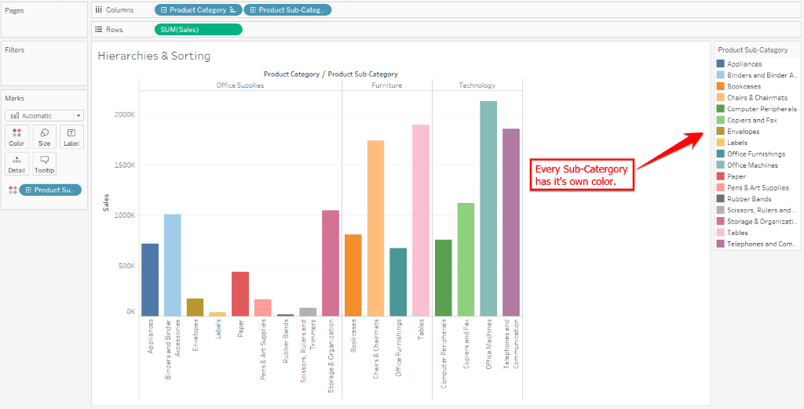
Advanced Visualization Tools

Slide 94
Advanced Visualization Tools
Using color can be helpful for visually grouping certain groups or categories.
As a possible example, let’s say your child was asked to compare all the heights of the students in their classroom. We’ll put the tallest kid first all the way down to the shortest. We build a bar chart to show all the heights and sort them. Then, we drop Gender on the Color shelf to see boys vs. girls. Largely, boys will tend to cluster at one end of the scale and girls at the other, but you’ll have a few outliers of really tall girls or shorter boys mixed in. Using the color encoding helps us quickly identify those.

Slide 95
Advanced Visualization Tools
You can change the color by clicking on the Color shelf. A window will pop up that gives you the options Edit Colors, Transparency, or Effects.
Click Edit Colors. A new window will pop up that shows which colors are assigned to which categories. You can choose a different color palette from the drop-down menu on the right side of the window.
Choose the Tableau 20 palette and click Assign Palette. You’ll now see all the categories on the left-hand side have a new color assigned.

Slide 96
Advanced Visualization Tools
But what if you wanted to change the colors individually, not let Tableau arbitrarily decide it? Let’s say for example, that you feel strongly that Rubber Bands needs to definitely be the color gray.
Since there isn’t any gray in the view, click the color palette menu and click Seattle Grays. Click on the Rubber Bands icon in list under “Select Data Item.” Now, choose the top gray. Click “Apply.” Notice how it changed just the Rubber Bands to be that gray color.

Slide 97
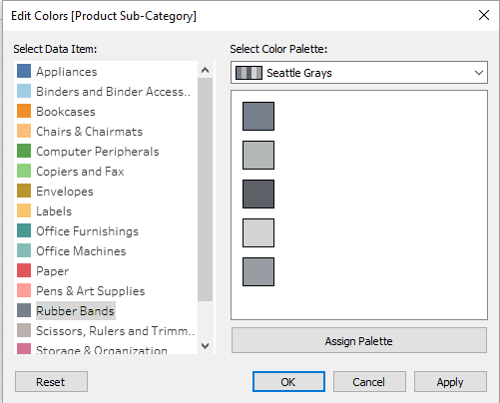
Advanced Visualization Tools
Now, click OK and notice the color selection of your entire view.

Slide 98
Advanced Visualization Tools
Next, drag Sub-Category off the color shelf. If Product Name is still on the Detail shelf, drag that one off as well. We should be back to our blue bar chart.
Drag Profit out to color now.
Remember that Profit is continuous, spanning from negative (i.e we’re in the red), to positive (in the black), and can be pretty much infinitely large or small.

Slide 99
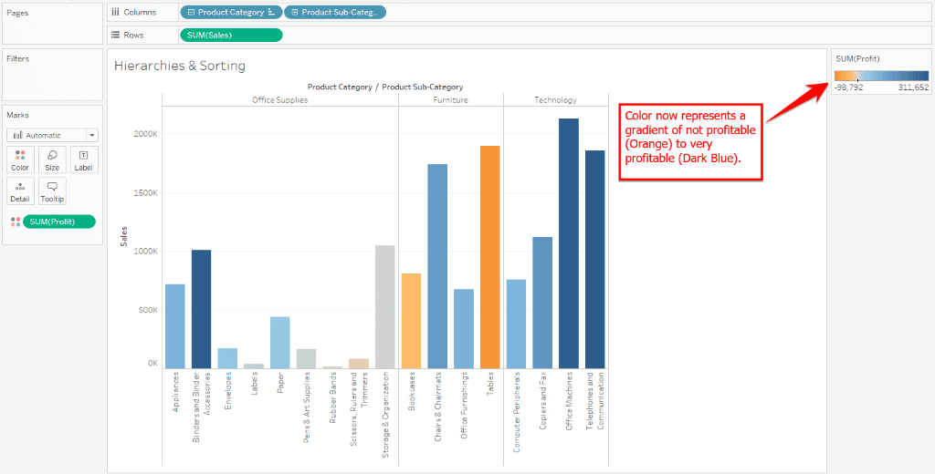
Advanced Visualization Tools

Slide 100
Advanced Visualization Tools
How to Create a Story in Tableau?
A story is a very powerful thing. It can influence its viewers and make them change their minds. It can take them through a journey that moves from various highs and lows and ends at a point that the storyteller wants. A story can also shock and surprise its viewers and provide them all the information they need to make the necessary decisions.

Slide 101
Advanced Visualization Tools
How to Create a Story in Tableau?
Step 1: Click on the new Story tab to create a new story. You can then add various sheets and dashboards to create a story point.
Step 2: You can double-click on the sheets and dashboards on the left to add them to a story point.
Step 3: We can also add a caption to summarize the story point by clicking on “Add a caption” and then writing it.
Step 4: It is possible to add another story point by 2 methods. You can either click on the Blank tab to use a blank sheet for the next story point or click on the Duplicate tab to obtain a duplicate sheet as the current story point.

Slide 102
Advanced Visualization Tools
How to Create a Story in Tableau?
Step 5: You can change the size of your story by clicking on the Size option in the lower-left corner. You can choose from one of the predefined sizes or set your custom size in pixels. You can also change the name of your story by right-clicking on your Story tab and choosing rename.
Step 6: Now, let’s see a complete story on the relationship between the discounted sales and profit

Slide 103
Advanced Visualization Tools
Create a Dashboard in Tableau
A dashboard is a consolidated display of many worksheets and related information in a single place. It is used to compare and monitor a variety of data simultaneously. The different data views are displayed all at once. Dashboards are shown as tabs at the bottom of the workbook and they usually get updated with the most recent data from the data source.
Using the Sample-superstore, plan to create a dashboard showing the sales and profits for different segments and Sub-Category of products across all the states. To achieve this objective, following are the steps.

Slide 104
Advanced Visualization Tools
Create a Dashboard in Tableau
Step 1 − Create a blank worksheet by using the add worksheet icon located at the bottom of the workbook. Drag the dimension Segment to the columns shelf and the dimension Sub-Category to the Rows Shelf. Drag and drop the measure Sales to the Color shelf and the measure Profit to the Size shelf.

Slide 105
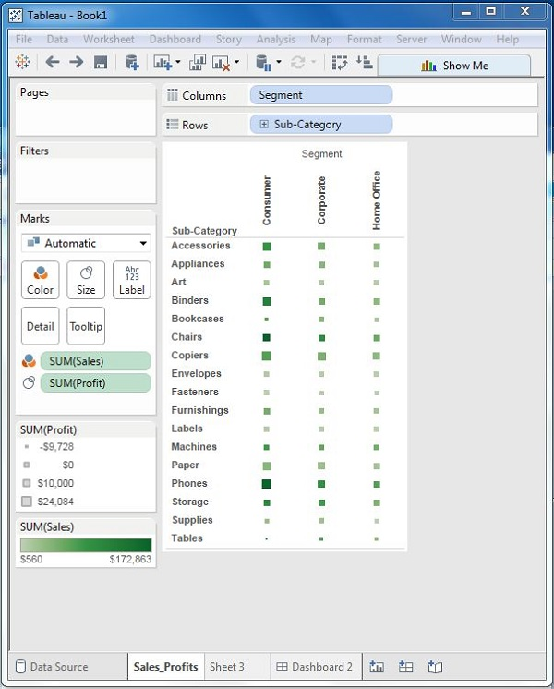
Advanced Visualization Tools
Create a Dashboard in Tableau
Step 1 −

Slide 106
Advanced Visualization Tools
Create a Dashboard in Tableau
Step 2 − Create another sheet to hold the details of the Sales across the States. For this, drag the dimension State to the Rows shelf and the measure Sales to the Columns shelf as shown in the following screenshot. Next, apply a filter to the State field to arrange the Sales in a descending order. Right-click and rename this worksheet as Sales_state.

Slide 107
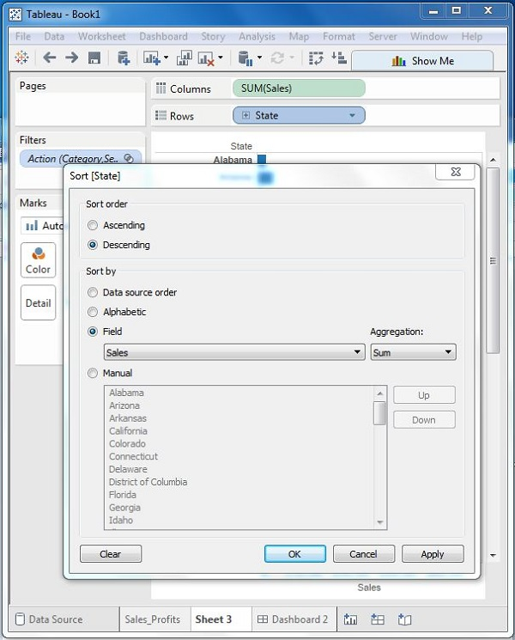
Advanced Visualization Tools
Create a Dashboard in Tableau
Step 2 −

Slide 108
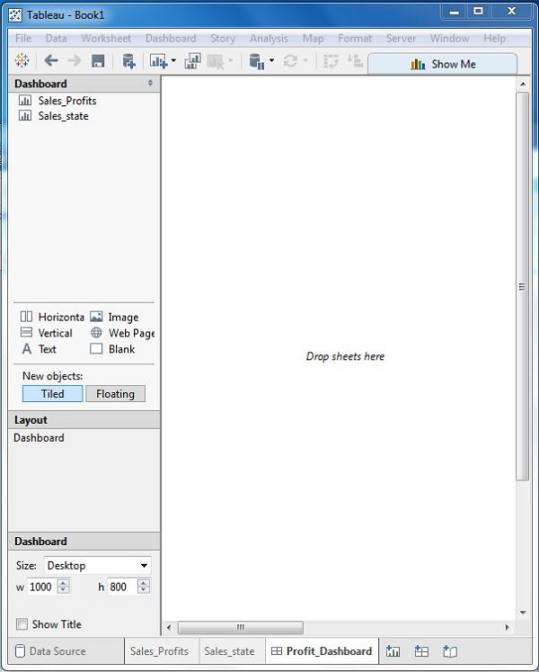
Advanced Visualization Tools
Create a Dashboard in Tableau
Step 3 − Next, create a blank dashboard by clicking the Create New Dashboard link at the bottom of the workbook. Right-click and rename the dashboard as Profit_Dashboard.

Slide 109
Advanced Visualization Tools
Create a Dashboard in Tableau
Step 4 − Drag the two worksheets to the dashboard. Near the top border line of Sales Profit worksheet, you can see three small icons. Click the middle one, which shows the prompt Use as Filter on hovering the mouse over it.

Slide 110
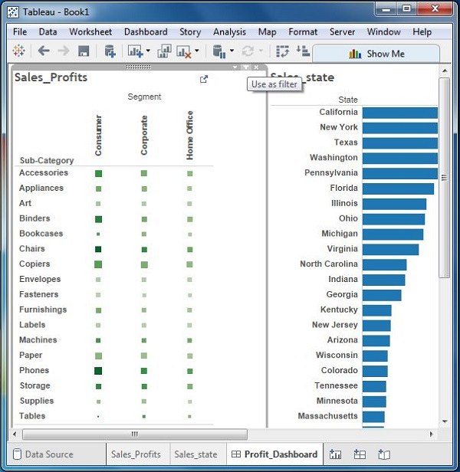
Advanced Visualization Tools
Create a Dashboard in Tableau
Step 4 −

Slide 111
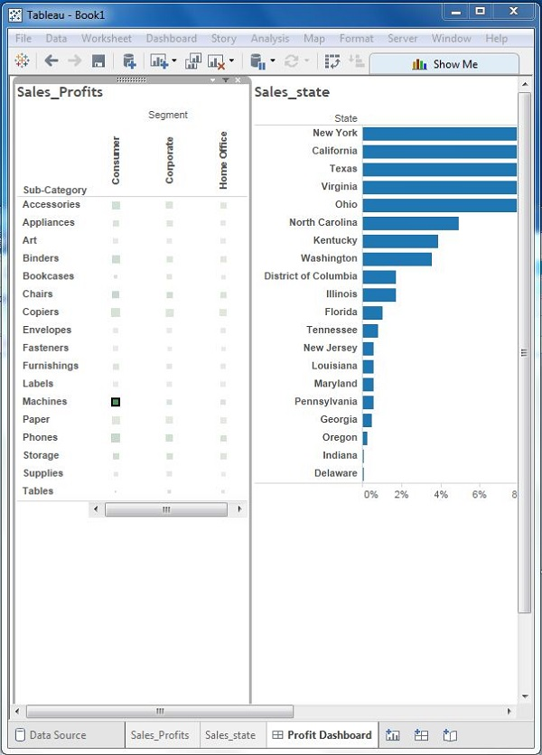
Advanced Visualization Tools
Create a Dashboard in Tableau
Step 5 − Now in the dashboard, click the box representing Sub-Category named Machines and segment named Consumer.

Slide 112
Advanced Visualization Tools
Publishing Your Visualizations
When people can see and understand the data, they solve problems and discover opportunities. Enable your group to find answers in minutes, not months.
There are 4 steps to publishing on the UW Tableau Server:
Develop your Visualization
Set up Permission Groups
Request a Project Folder
Publish Your Work

Slide 113
Advanced Visualization Tools
Publishing Your Visualizations
1. Develop using Tableau Desktop
Create your dashboard or visualization using Tableau Desktop software. When you are ready to share your work with colleagues, you can publish to the UW Tableau Transitional Server.
To publish to the UW Tableau Server, you must use a version of Tableau Desktop that is compatible with UW’s Tableau Server. The important thing to remember is that your Tableau Desktop version should not exceed the latest version of the server.

Slide 114
Advanced Visualization Tools
Publishing Your Visualizations
2. Set up Permission Groups
UW Groups are a core development building block at the University of Washington. Before you create groups to manage permissions, it may be helpful to first get acquainted with the UW Groups Service: UW Groups
Tableau developers/project-owners, you will self-manage who has access to your project’s visualizations.

Slide 115
Advanced Visualization Tools
Publishing Your Visualizations
2. Set up Permission Groups
There are three roles to consider:
Viewer
Editor (creator)
Publisher

Slide 116
Advanced Visualization Tools
3. Request a Project Folder on the UW Tableau Transitional Server:
Now that you have your permission groups configured, you’ll need to request a “project folder” on the UW Tableau Transitional Server. Your “project folder” on the server is your very own location to publish the data visualization you built on your desktop. Once you publish your work, you’ll be able to share it with your colleagues. Only the users (net ids in the groups you created) will be able to see your work on the server.

Slide 117
Advanced Visualization Tools
4. Publish to the Transitional Server
Okay, you’ve tested your dashboard, set up permissions, and it’s time to share your work with your colleagues on the UW Tableau Transitional Server.

Slide 118
Daily Quiz
What Are the Data Types Supported in Tableau? ...
How Will You Understand Dimensions and Measures? ...
What is Meant by 'discrete' and 'continuous' in Tableau? ...
What Are the Filters? ...
There Are Three Customer Segments in the Superstore Dataset. ...
What Are the Different Joins in Tableau?
What is the Difference Between a Live Connection and an Extract?
What is a Calculated Field, and How Will You Create One?
How Can You Display the Top Five and Bottom Five Sales in the Same View?
Is There a Difference Between Sets and Groups in Tableau?

Slide 119
Weekly/monthly/Unit Wise Assignment.
Assignment 1
What is the Difference Between Tree-maps and Heat Maps?
What is a Parameter in Tableau? Give an Example.
Write steps for installation of Tableau.
Write Overview of SUM, AVR, and Aggregate features ,Creating custom calculations and fields.
Explain How to apply Applying new data calculations to your visualization.
What Are the Different Joins in Tableau?
What is the Difference Between a Live Connection and an Extract?
What is a Calculated Field, and How Will You Create One?
How Can You Display the Top Five and Bottom Five Sales in the Same View?
Is There a Difference Between Sets and Groups in Tableau?

Slide 120
Faculty Video Links, You tube & NPTEL Video Links and Online Courses Details
You Tube video Links
https://www.youtube.com/watch?v=6mBtTNggkUk
https://www.youtube.com/watch?v=HGMrIZq5dq0
https://www.youtube.com/watch?v=ttCDqyfrcEc

Slide 121
MCQ unit wise/weekly
1.What is Tableau
Tableau is a people in Business Intelligence Industry
Tableau is suitable for factory industry only
Tableau is a new alternative for data programming
Tableau is a powerful and fastest growing data visualization tool used in the Business Intelligence Industry

Slide 122
MCQ unit wise/weekly
2.Calculations in Tableau
Numerical
String
Date
All of above

Slide 123
MCQ unit wise/weekly
3.What are the file extensions in Tableau ?
Tableau Workbook (.twb)
Tableau Packaged Workbook (.twbx)
Tableau Data Source(.tds)
All of the above

Slide 124
MCQ unit wise/weekly
4.Data Values available for the visualization
Table Calculation
Basic Expression
LoD Expression
None of the above

Slide 125
MCQ unit wise/weekly
5.)How many maximum tables can you join in Tableau?
2
8
16
32

Slide 126
MCQ unit wise/weekly
6.)What are the components of a Dashboard?
Horizontal
Vertical
Image Extract
All of the above

Slide 127
MCQ unit wise/weekly
7.)Which of the following Data Pane items cannot be dragged onto the Filters Shelf?
Dimensions
Parameters
Sets
Measures

Slide 128
MCQ unit wise/weekly
8.Which of the following is NOT a Tableau Field data type?
Number (whole)
String
Boolean
Float

Slide 129
MCQ unit wise/weekly
9.)Views in Tableau
Sheet
Dashboard
Story
All of above

Slide 130
MCQ unit wise/weekly
10.)Which of the following files types contains a Tableau Workbook along with local data?
.twb
.twbx
.hyper
.tde

Slide 131

Glossary Questions
1. Raw Data ig original _______ of data.
2.Creating reproducible _______ is performed by Data Scientist.
3. Hadoop is a framework that works with a variety of related tools. Common cohorts include ____________.
4. __________characteristic of big data is relatively more concerned to data science.
5. ____________analytical capabilities are provided by information management company?
6. __________step is performed by data scientist after acquiring the data.
7. _______ are not sufficient to describe big data.
8. _____focuses on the discovery of (previously) unknown properties on the data.
9. As companies move past the experimental phase with Hadoop, many cite the need for additional capabilities, including _______________.
10. Data in ____ bytes size is called big data. ...

Slide 132
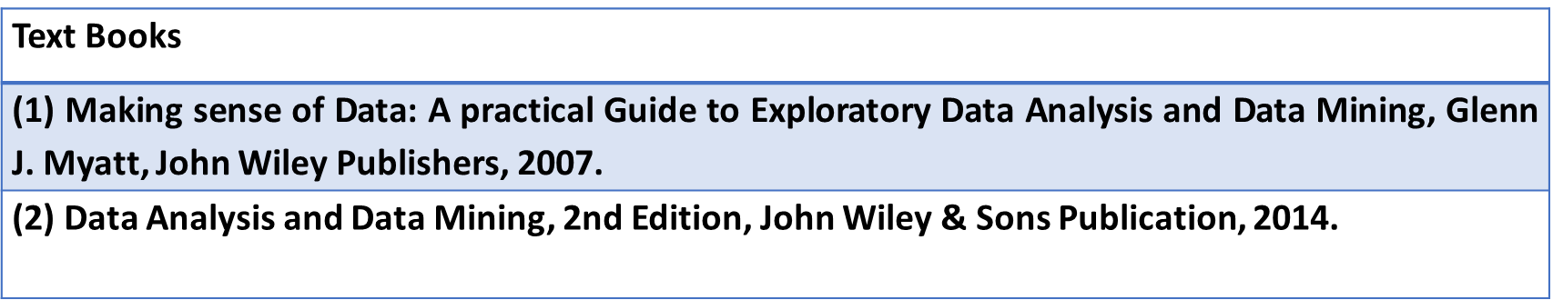
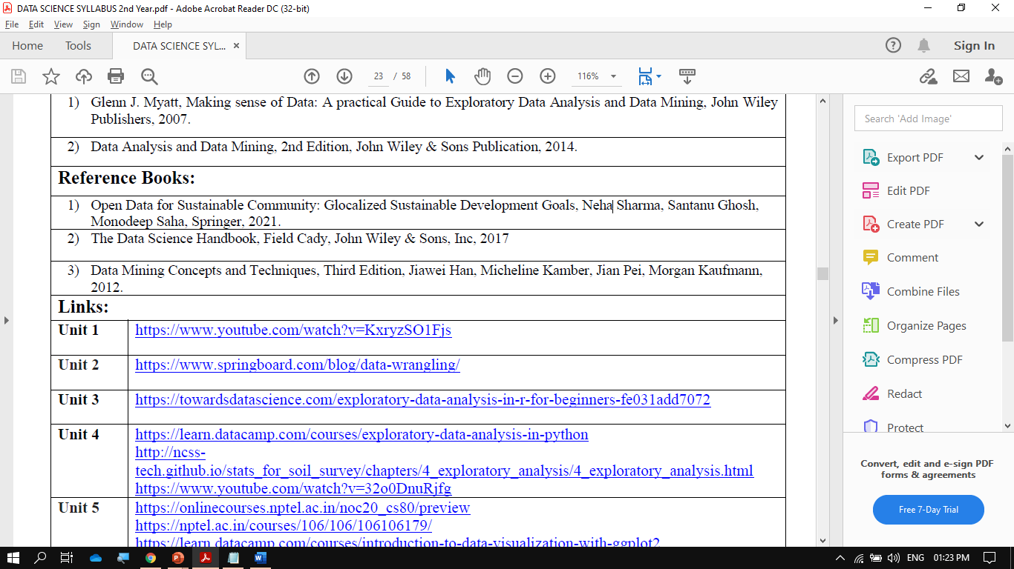
References

Slide 133
Expected Questions for University Exam
1.What is data science and its benefits?
2. Explain role and stages in data science?
3. What are the goals of data science?
4. What is data Analysis? Why python is used for data analysis?
5. Explain supervised and unsupervised machine Learning?
6. Why we need the machine Learning in data science?
7.Explain general techniques for handling volumes of data?
8.What are the problems face when handling large data?
9.Explain different stages of data Science?
10.Difference between data Analysis and analytics?

Slide 134
Thank You

